Slide 1

MALIGNANT COMMENTS CLASSIFICATION
Nazia Sultana Khan

Slide 2
Problem Statement Analysis
Social media platforms are the most prominent grounds for toxic behaviour
There has been a remarkable increase in the cases of cyberbullying and trolls on various social media platforms.
Although researchers have found that hate is a problem across multiple platforms, there is a lack of models for online hate detection.
Our goal is to build a prototype of online hate and abuse comment classifier which can used to classify hate and offensive comments so that it can be controlled and restricted from spreading hatred and cyberbullying.

Slide 3
Data set description
The data set contains the training set, which has approximately 1,59,000 samples and the test set which contains nearly 1,53,000 samples. All the data samples contain 8 fields which includes ‘Id’, ‘Comments’, ‘Malignant’, ‘Highly malignant’, ‘Rude’, ‘Threat’, ‘Abuse’ and ‘Loathe’.
The label can be either 0 or 1, where 0 denotes a NO while 1 denotes a YES. There are various comments which have multiple labels.
The first attribute is a unique ID associated with each comment.

Slide 4
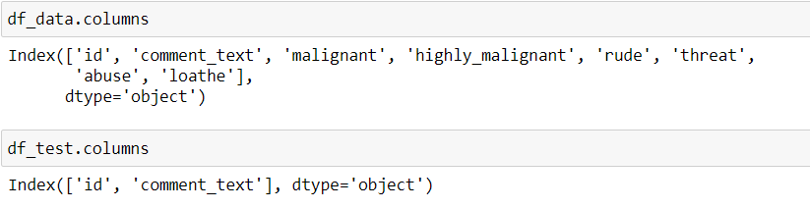
Exploratory data analysis process

Slide 5
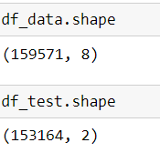
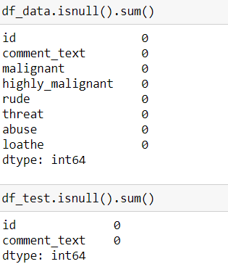
Exploratory data analysis process
Using the shape we find out the total number of rows & columns present in the dataset.
There is no null values present
in the dataset.

Slide 6
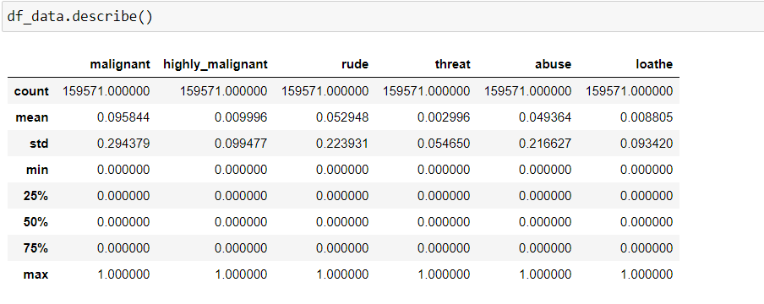
Exploratory data analysis process

Slide 7
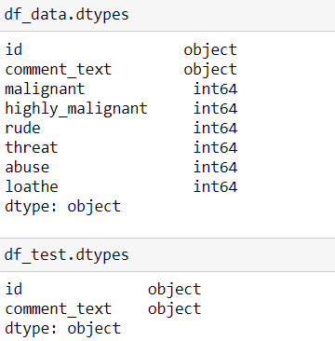
Exploratory data analysis process
By using “dtypes” we got to know the data types for each of the columns. Mostly data type are int64 in nature for training dataset and for test data type are classified under object type.

Slide 8
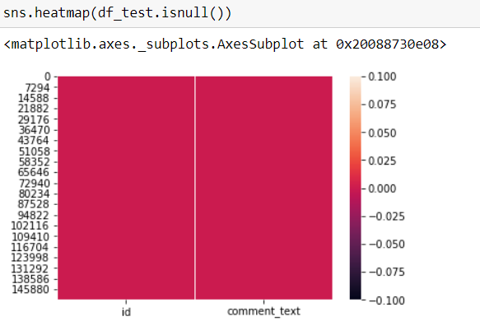
Data Visualization process
From the above visualizations using heatmap we are trying to find out if there is any null value present in the testing dataset of the project. As clearly shown using the heatmap there is no null value present in the test dataset.

Slide 9
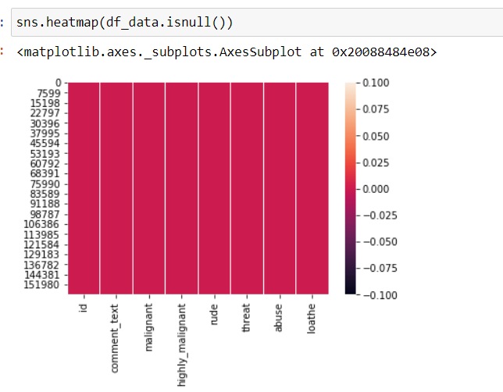
Data Visualization process
From the above visualizations using heatmap we are trying to find out if there is any null value present in the training dataset of the project. As clearly shown using the heatmap there is no null value present in the training dataset.

Slide 10
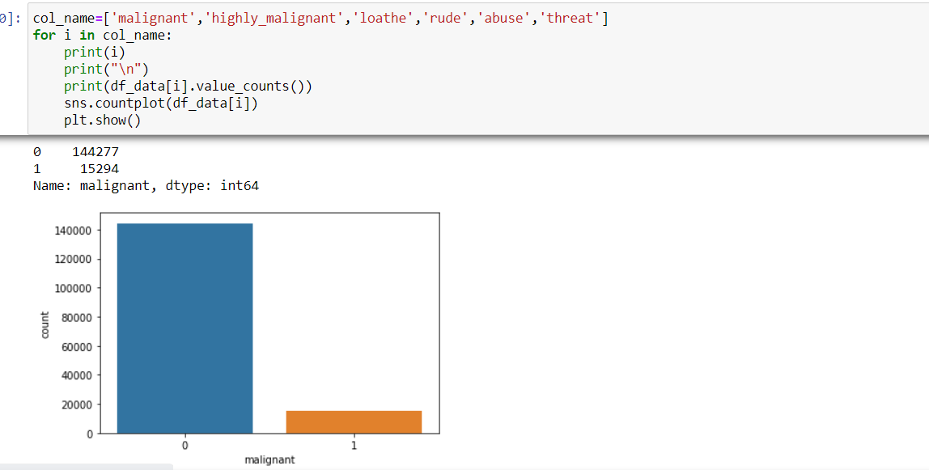
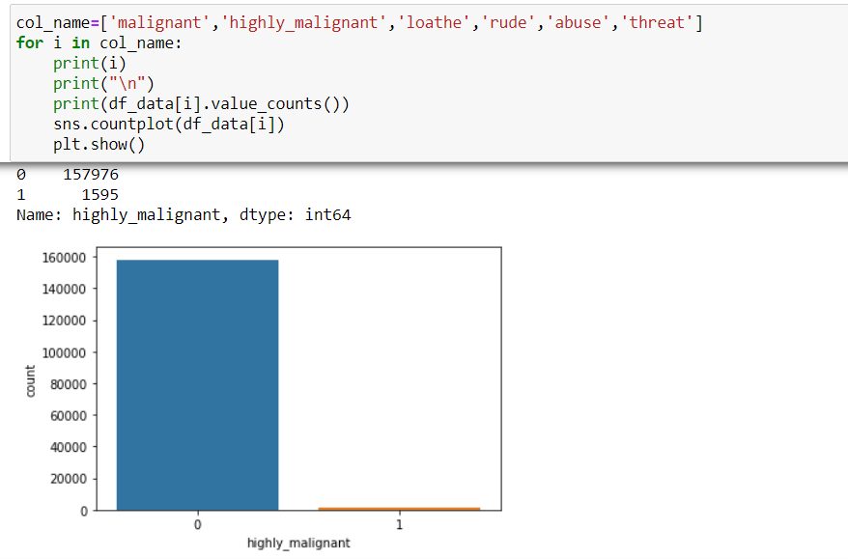
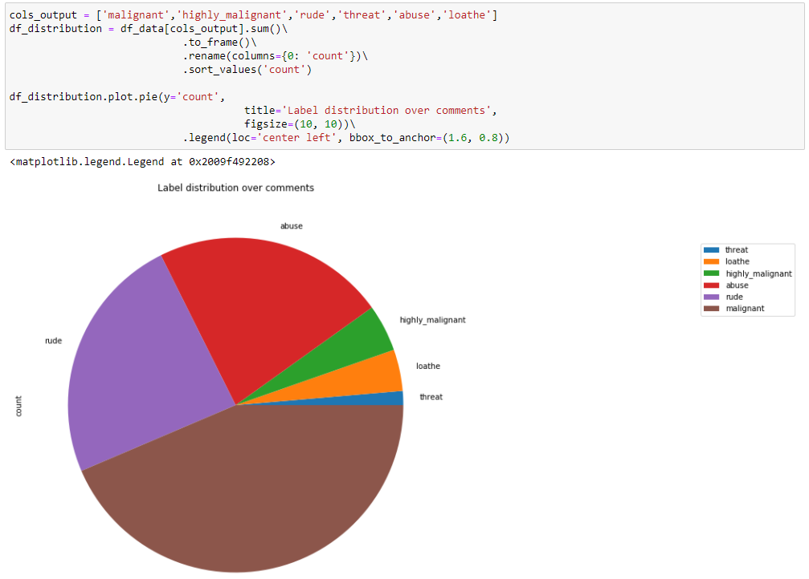

Slide 11
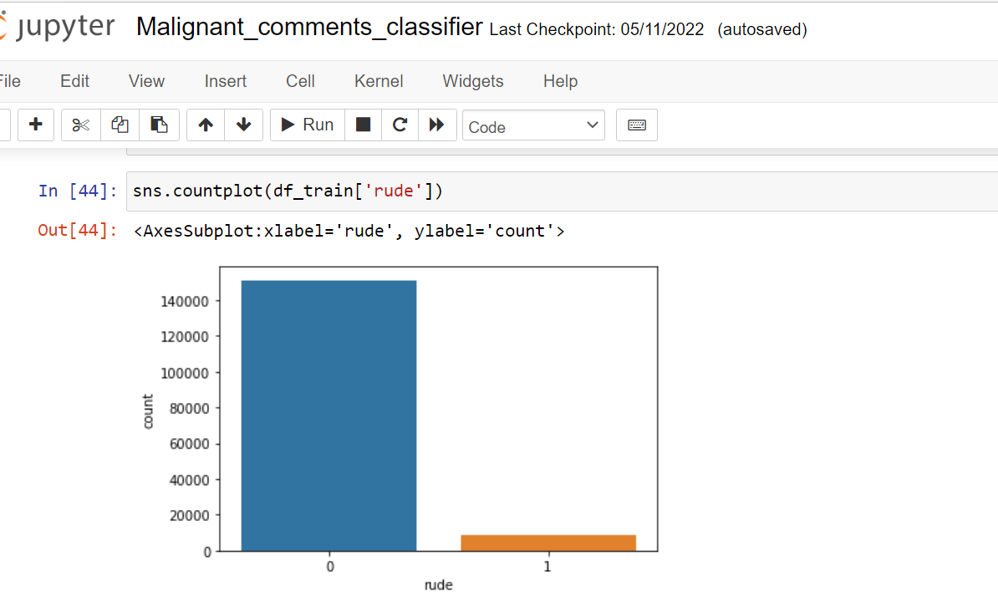
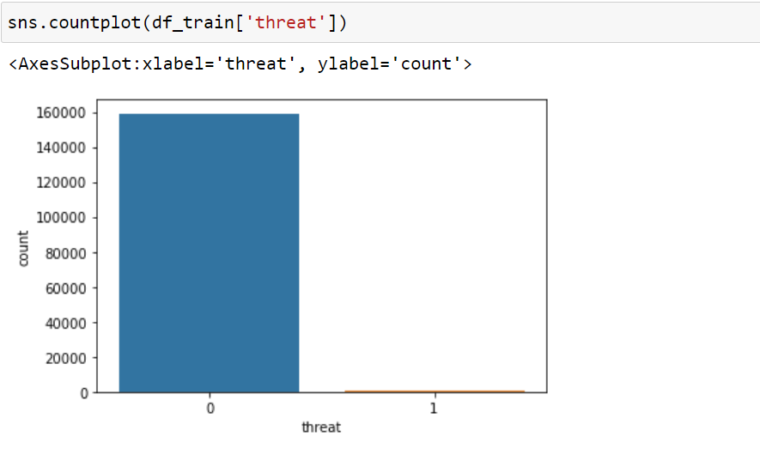
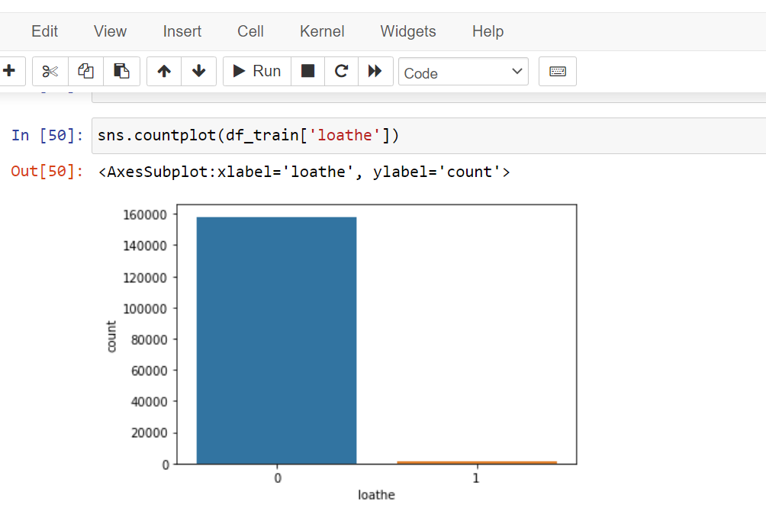
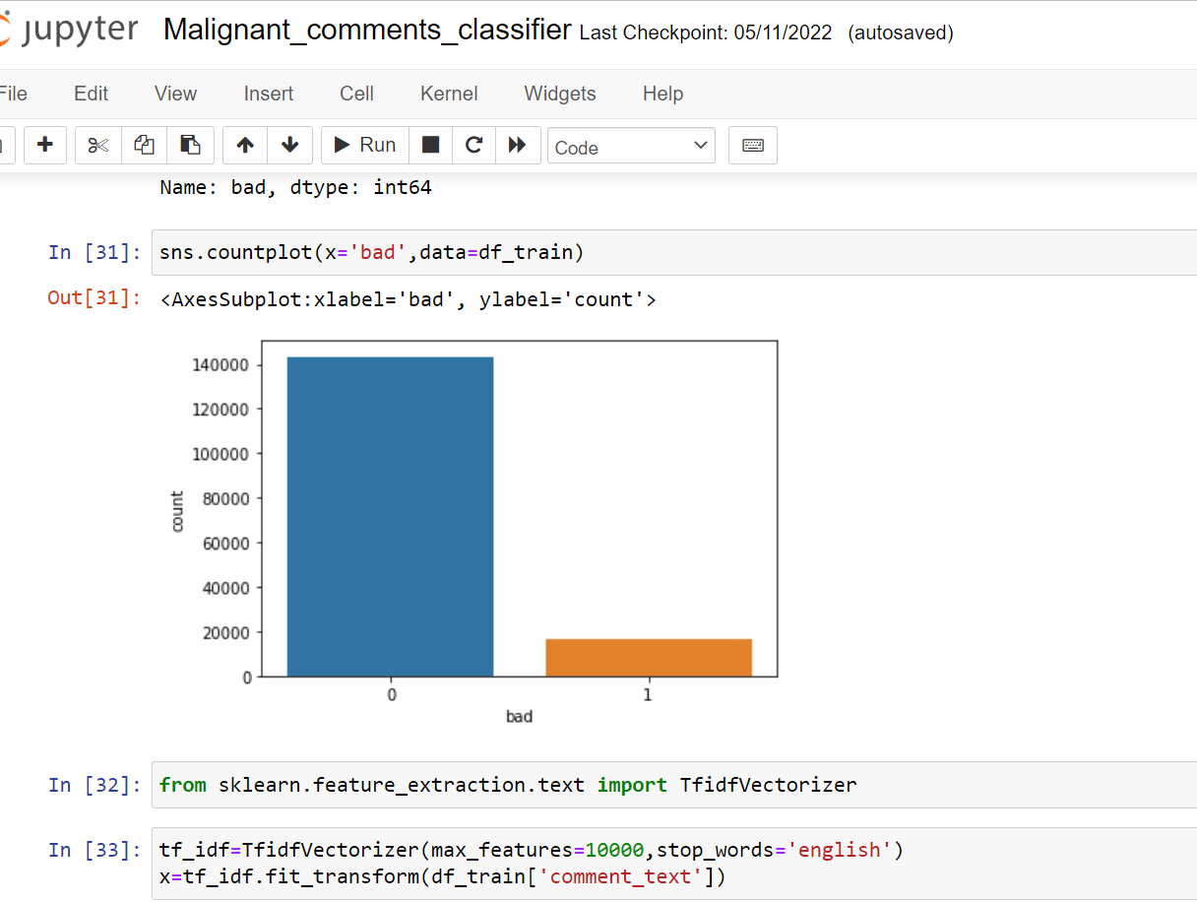

Slide 12
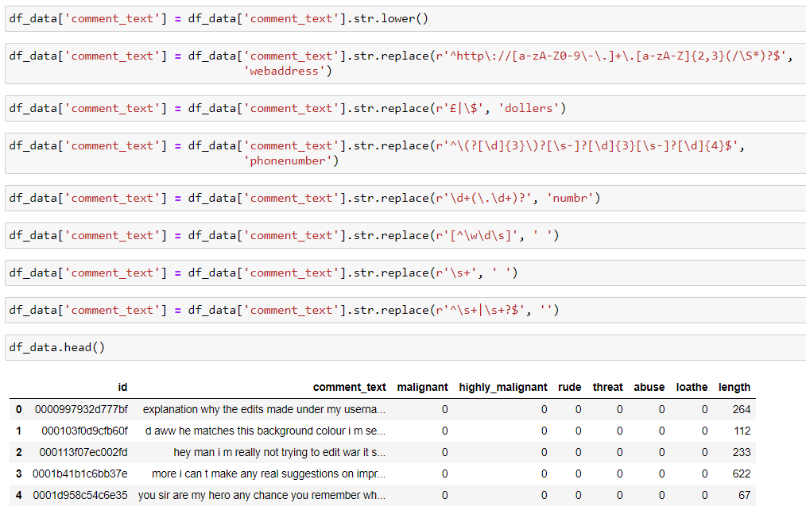
Data preprocessing stage

Slide 13
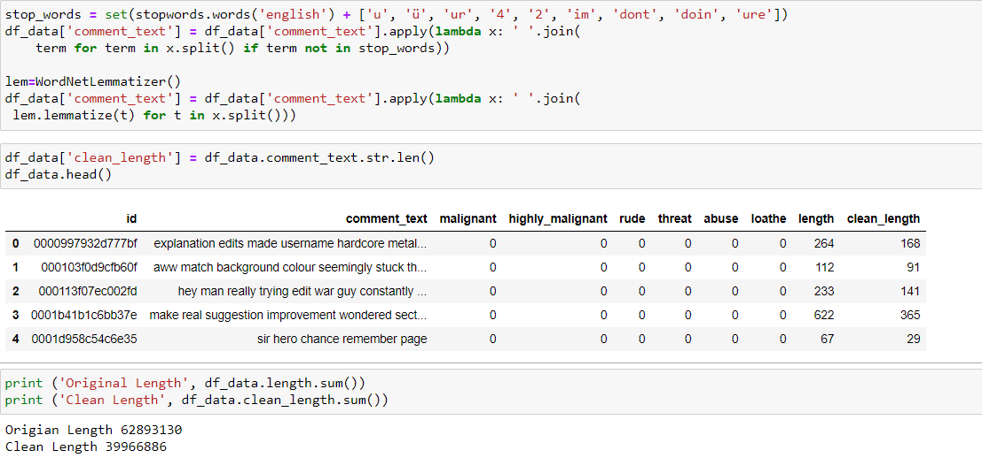
Data preprocessing stage

Slide 14
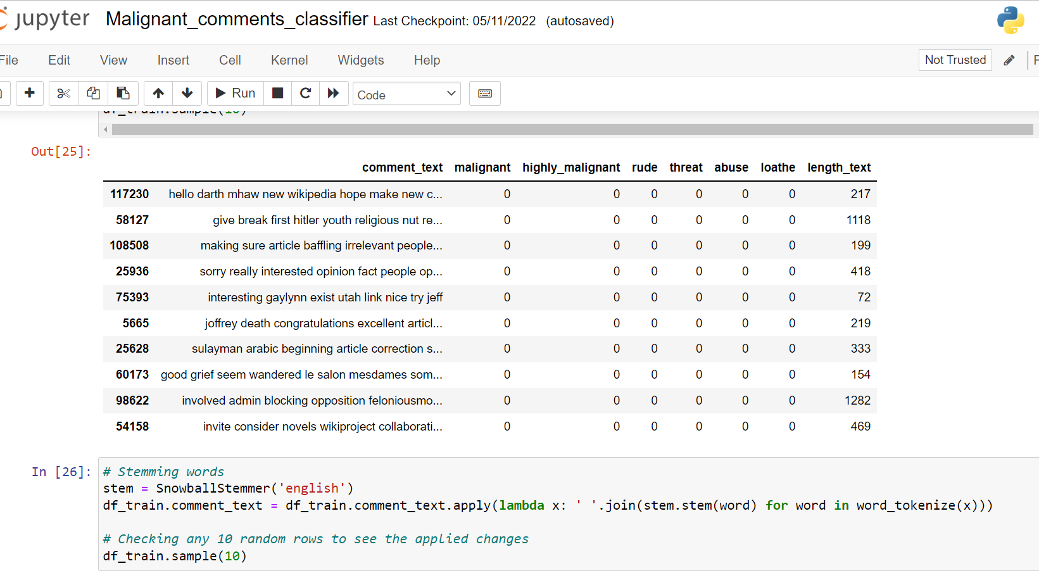
Data preprocessing stage

Slide 15
Model building process
In this dataset, I classified “bad” as the target variable which is a binary classification data, hence we have used various classification method for Machine learning model building process.
I have come across some features for malignant/highly malignant comments which handled as per the my understanding.
Proposed a random forest classifier model to predict the best accuracy score , also used cross validation to find the trade off between bias-variance.

Slide 16
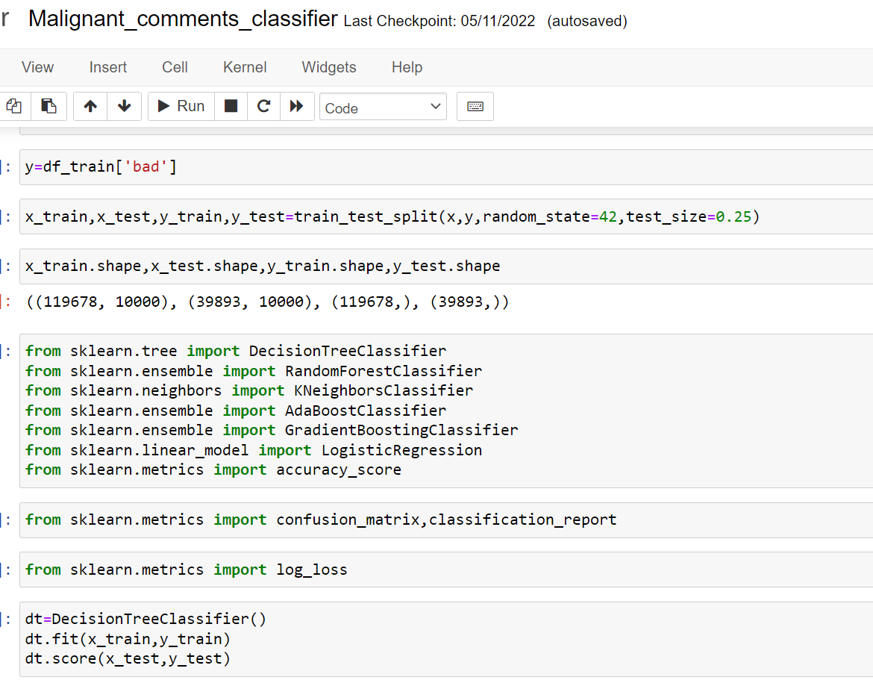
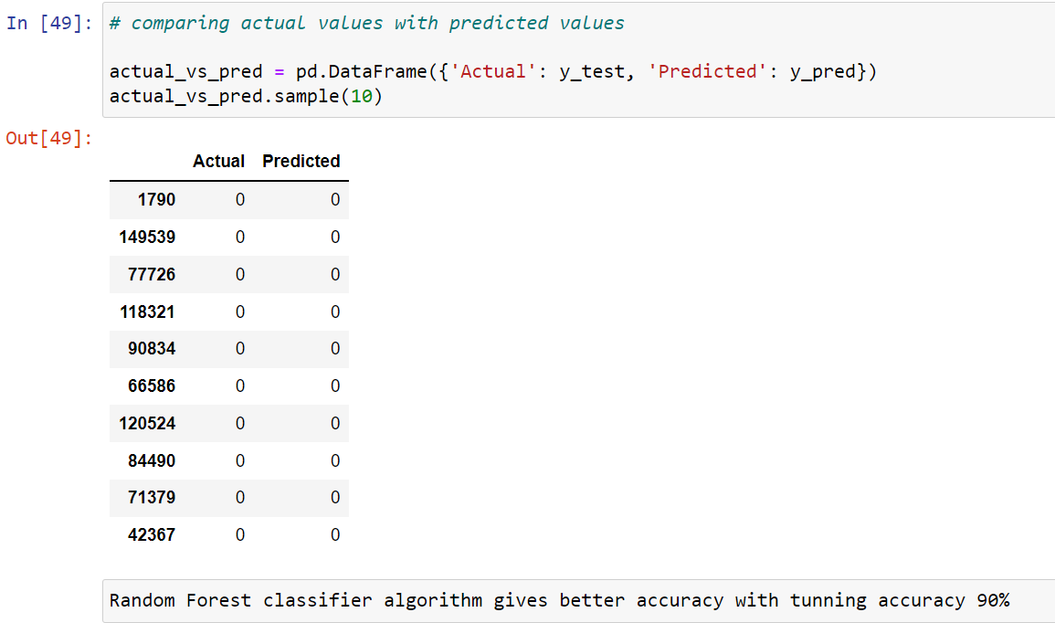

Slide 17
Model Comparison
ML Algorithm Used | Predicted Score
Random Forest Classifier | 95.77%
Decision Tree Classifier | 94.22%
Gradient Boosting Classifier | 94.08%
Ada Boosting Classifier | 94.59%
k neighbors classifier | 91.60%
Xgboost Classifier | 95.46%
Logistic Regression | 95.62%
To predict the result of this dataset above are classification models used for evaluations.
Out of all the machine learning models used I have selected Random forest classifier model for further evaluation of this dataset.

Slide 18
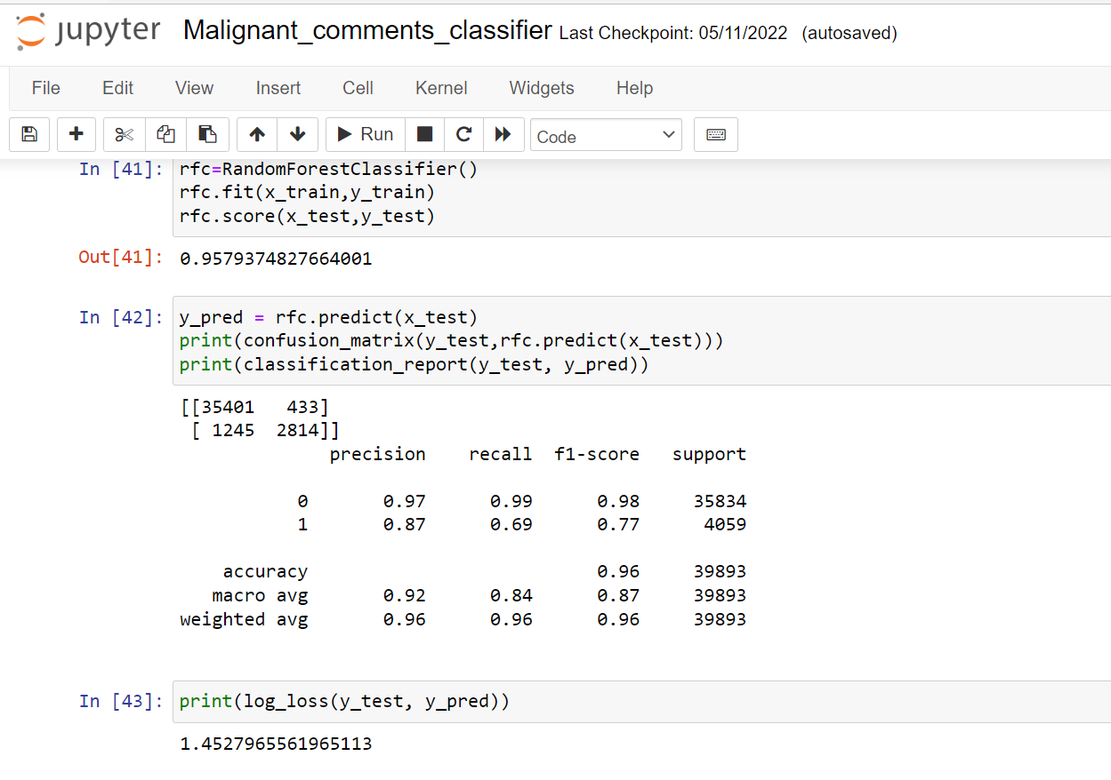
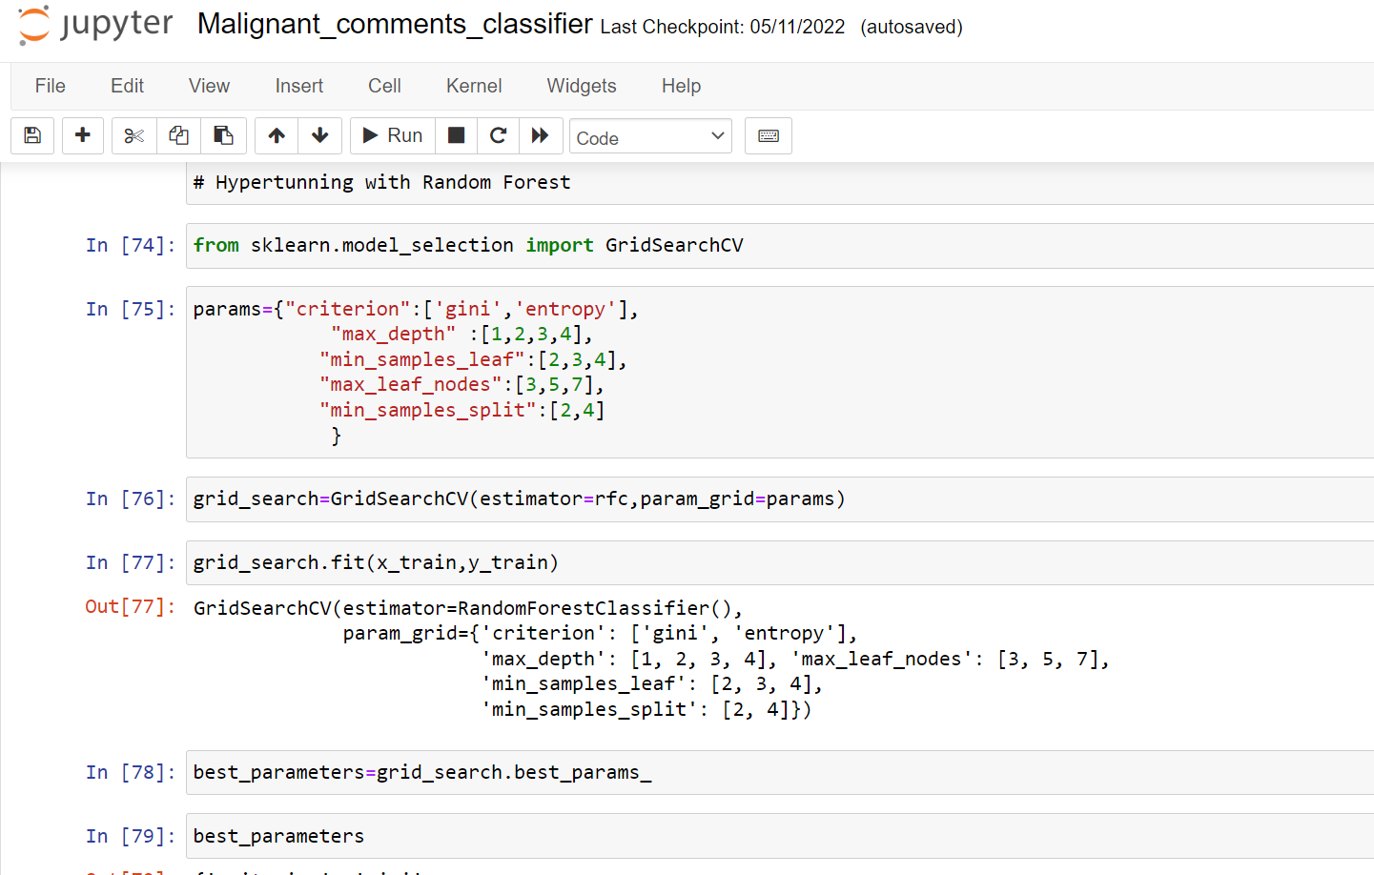
Interpretation Of Result

Slide 19
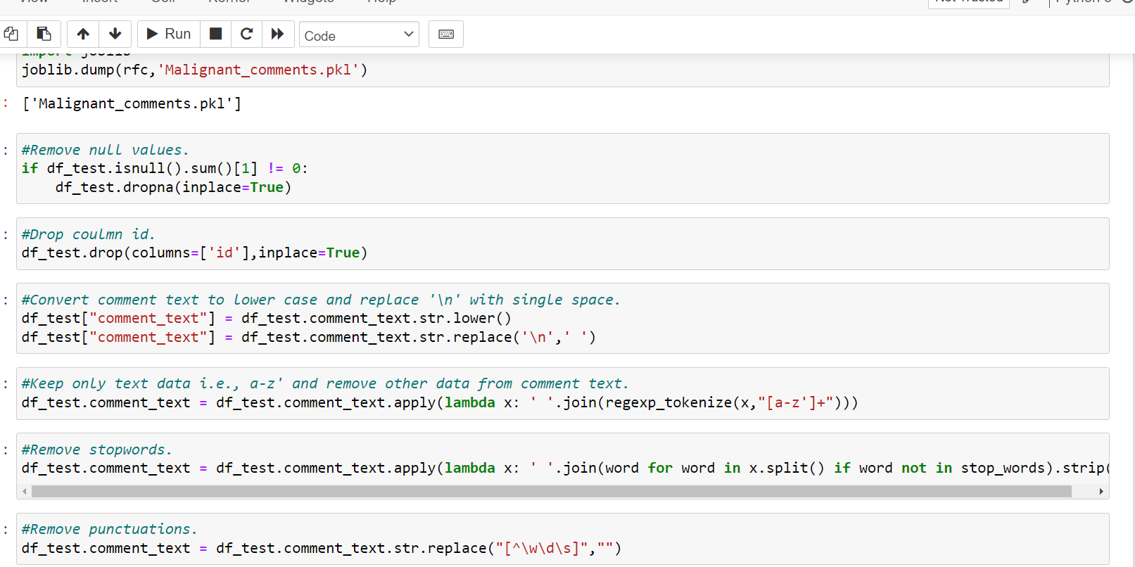
Interpretation Of Result

Slide 20
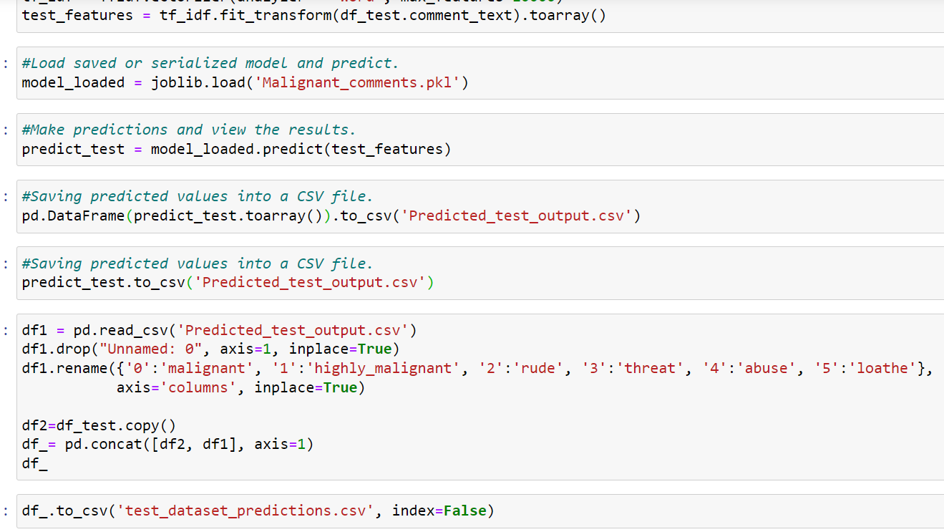
Interpretation Of Result

Slide 21
CONCLUSIONS
I have used various classifications methods and out of all algorithm, random forest classifier yields the best results.
I have also used cross validation technique to find the trade-off between bias& variance
These malignant comments classification can be used by social media companies to filter and classify some keywords as highly malignant and set their own policy going forward for the customers and other shareholders.

